Slide 1
Logistics: Project
Project presentation
Dec 6/8 during lectures
Everyone is expected to attend both lectures
10 minutes for presentation + 1~2 minutes for QA and transition
Project reports
Due: Dec 9 (no late submissions)
Up to 6 pages (plus additional pages for only references/citations)
No strict format requirements
You are encouraged to use standard templates
More details will be announced later

Slide 2
Peer Review
Please submit the peer review by 6pm

Slide 3
Lecture 19 Human Perceptions of Fairness
Instructor: Chien-Ju (CJ) Ho

Slide 4
More Discussion on Recidivism Prediction

Slide 5
Human Compared with ML [Dressel and Farid. 2018]

Slide 6
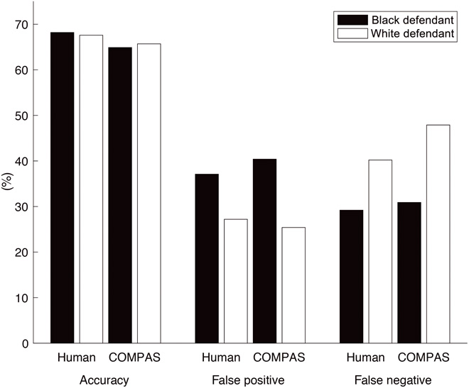
Human Compared with ML [Dressel and Farid. 2018]
Humans are closely on par with ML for this task in both accuracy and fairness.
Caveat:
Humans are learning (seeing ground truth) in this experiment

Slide 7
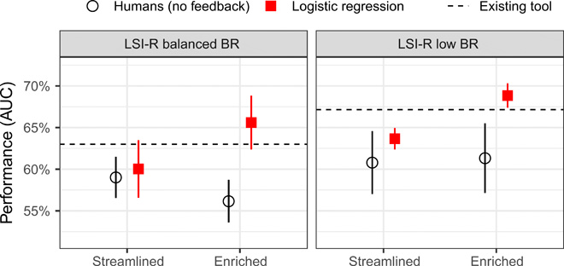
A Follow-Up Study [Lin et al. 2020]
Change three factors
Whether humans obtain truth feedback
Base rates of the recidivism
Amount of information given to users

Slide 8
A common theme
Giving the control to humans
The goal of AI is to augment, not replace, humans
As a human, this sounds good….

Slide 9


Think About Problem 3 in Assignment 3
Company aims to hire interns
Only 30% students satisfy the requirement and the company knows that
I can make them hire 60% by manipulating the information

Slide 10


Think About Problem 3 in Assignment 3
Company aims to hire interns
Only 30% students satisfy the requirement and the company knows that
I can make them hire 60% by manipulating the information
The example in the original paper [Kamenica and Gentzkow. 2011]
Company -> Judge
Teacher -> Prosecutor

Slide 11


Think About Problem 3 in Assignment 3
Company aims to hire interns
Only 30% students satisfy the requirement
I can make them hire 60% by manipulating the information
The example in the original paper [Kamenica and Gentzkow. 2011]
Company -> Judge
Teacher -> Prosecutor
Let’s extend it a bit
Company -> Human
Teacher -> AI

Slide 12
AI-Assisted Decision Making
We will discuss these at the last two lectures

Slide 13
AI-Assisted Decision Making
The idea is nice => AI is helping humans to make decisions
AI might also be able to manipulate humans to make decisions
Think about recommendation letter writing
Let’s just ask AI to present all information
Exceed the human cognitive load
Who to decide what AI should do?

Slide 14

Participatory Design (more on Thursday)

